Slide 1
Hybrid Quantum Neural Networks: Analysis of Efficiency, Accuracy, and Applications
Andrew Nerud
CSCI 373

Slide 2
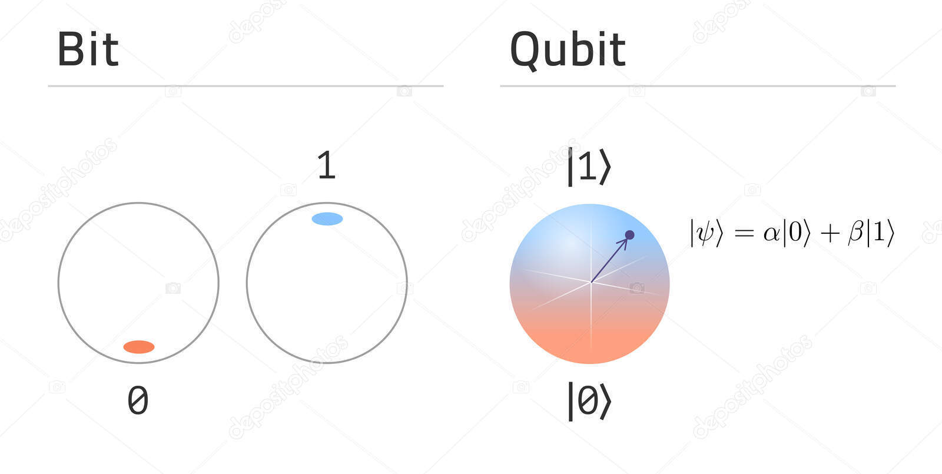

Quantum Definitions
Qubit
Entanglement
Quantum Gates
Measurement

Slide 3
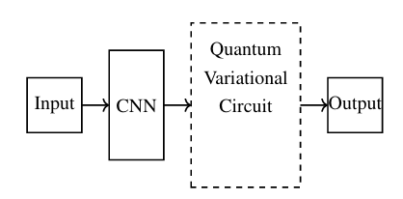
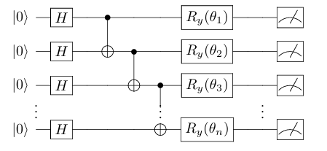
What is a HQNN?
HQNN Architecture – both classical and quantum components
VQCs – the quantum part of the HQNN
Some number of qubits
Gates with trainable rotation parameters

Slide 4
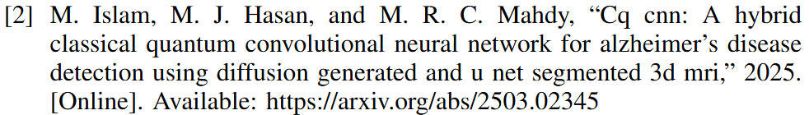
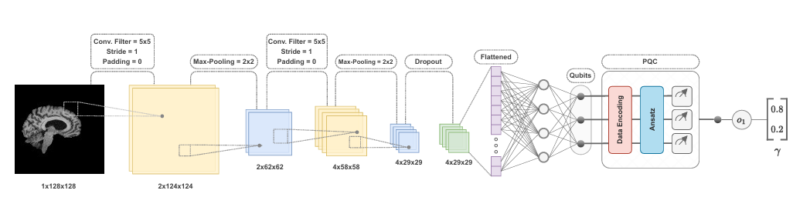
Alzheimer’s MRI Processing HQNN Example

Slide 5

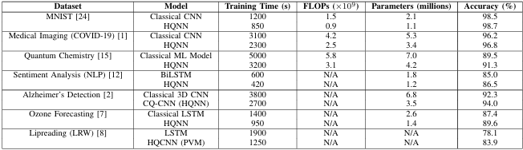
Current HQNNs’ Performance
Smaller Datasets and Simulator Usage
HQNNs can be effective

Slide 6
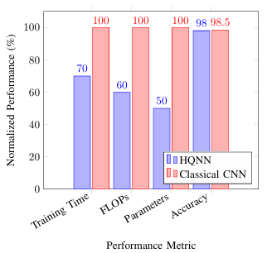

Additional Performance Visual

Slide 7

Current Quantum Issues
NISQ Era
Hardware Limitations
Coherence Times
Quantum-Classical Delays

Slide 8
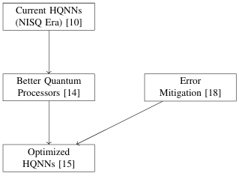
Future of HQNNs
1. Hardware Improvements
3. Real-World Introduction
2. Optimized HQNNs
4. Fully Quantum NNs

Slide 9
Ethics and Industry Readiness
Think about using a model with healthcare, finance, or autonomous systems
For these purposes, we need:
Reliability
Interpretability

Slide 10
Final Thoughts
HQNNs show real efficiency gains
Noise and Quantum-Classical challenges
Performance and Transparency Balance
Transitional Architecture
Quantum Advantage

Slide 11
Thanks for Listening!

